Slide 1
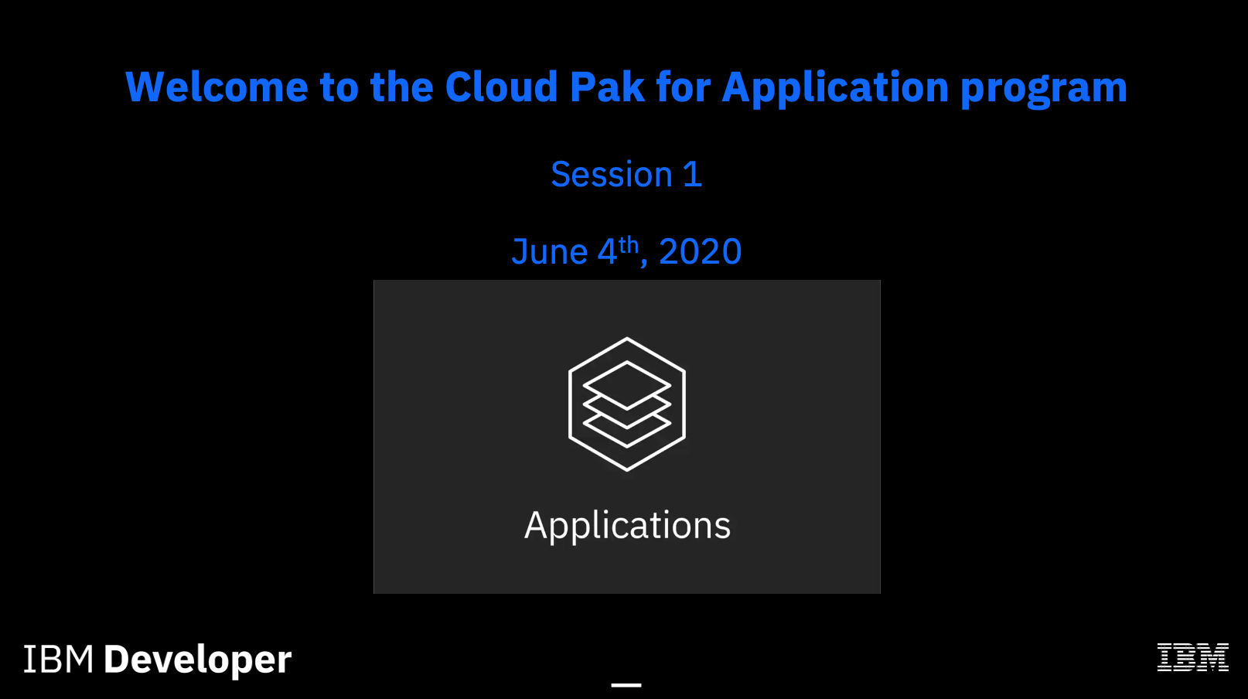

Slide 2
Agenda:
OpenShift – What?
Flavors of OpenShift
Architecture of Installing & working with OpenShift
Containers
Why do we need Containers
What containers can do
Difference between Containers & VM
Docker
Docker Components
OpenShift Components
Kubernetes & OpenShift : What is the difference
OpenShift Web Console walkthrough
OpenShift CI walkthrough
Projects
Routes- Services
Scale

Slide 3
Move & Modernize apps - Docker,k8s,OpenShift —

Slide 4
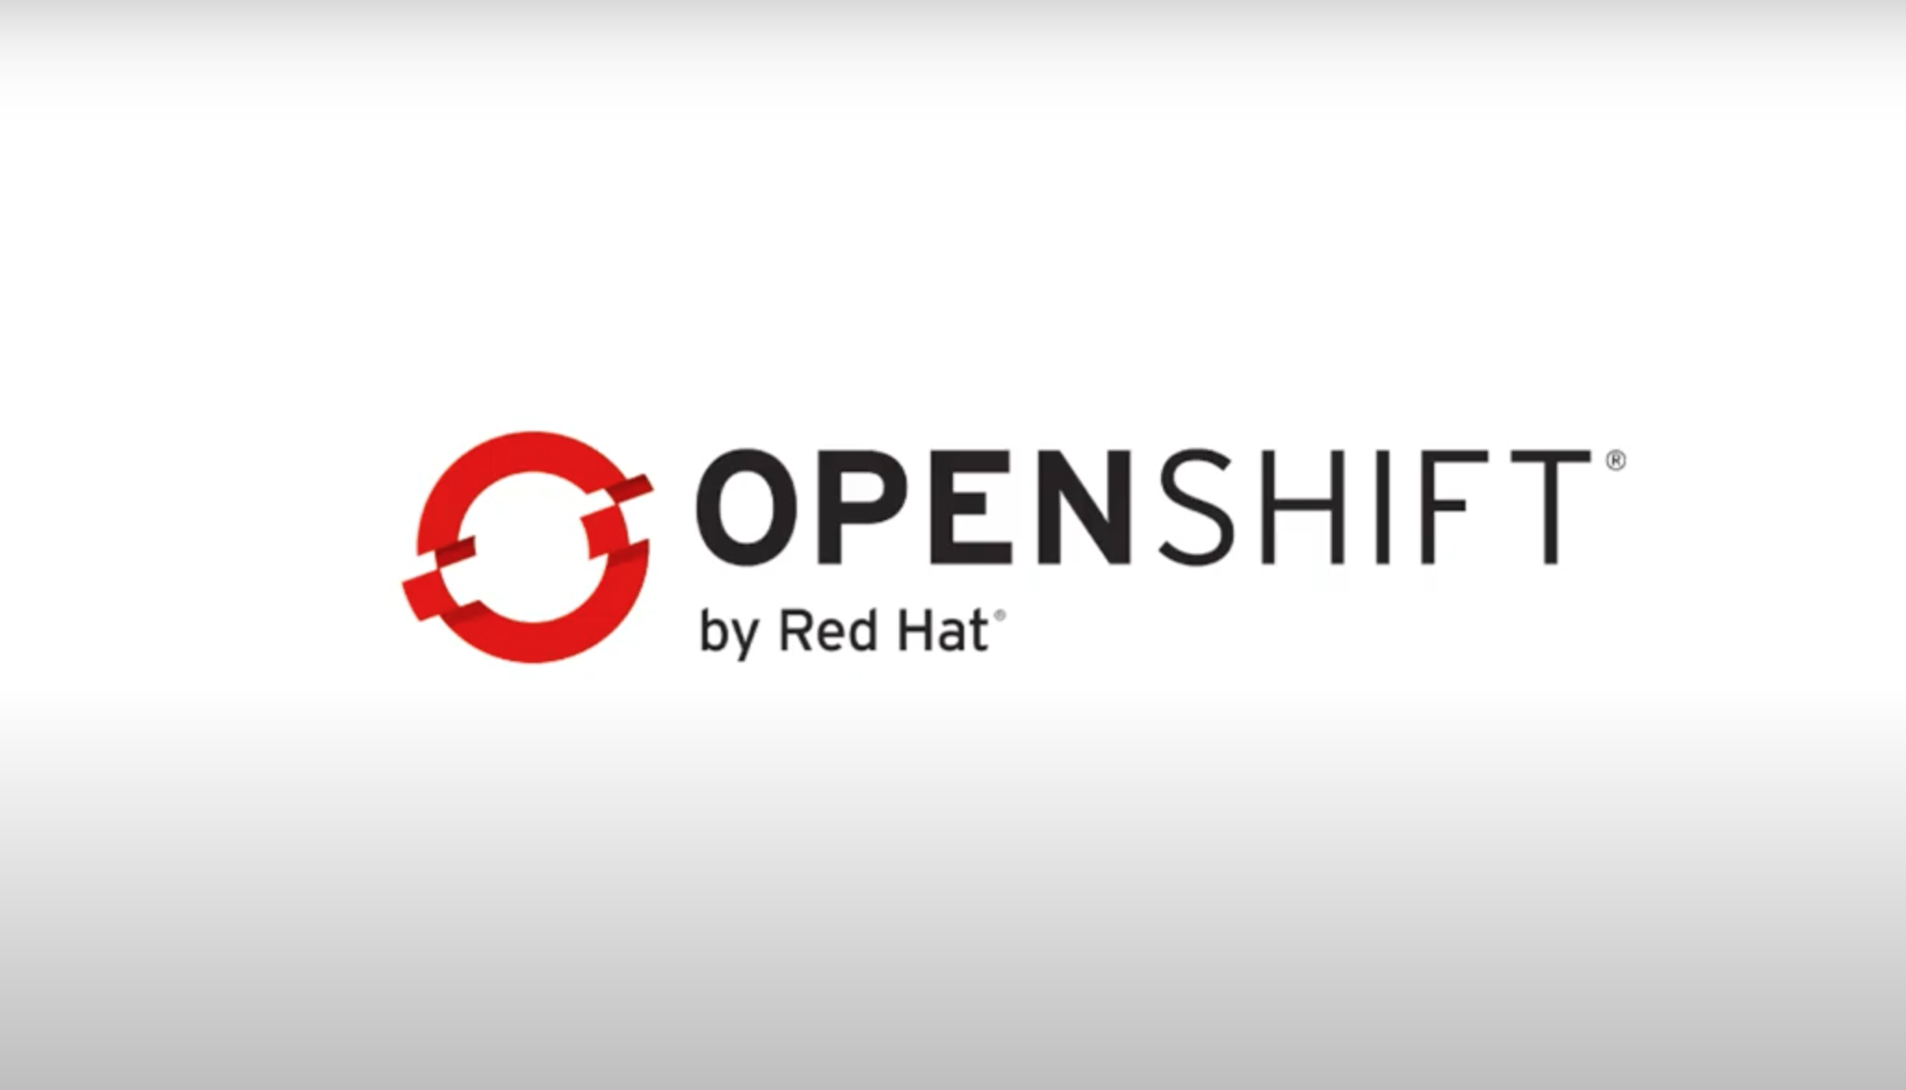

Slide 5
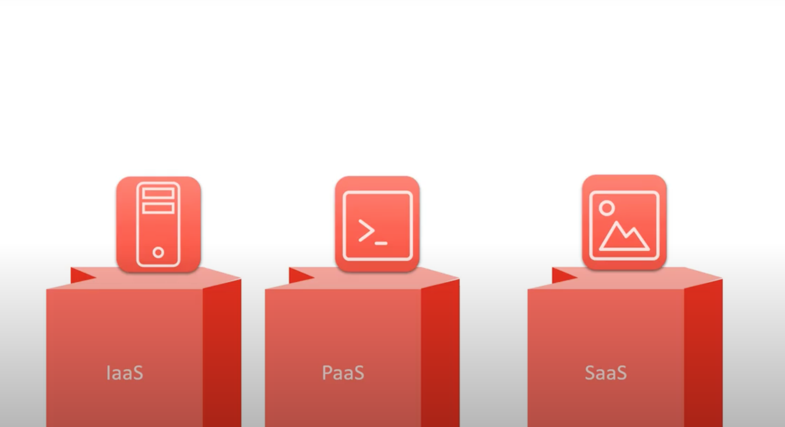

Slide 6
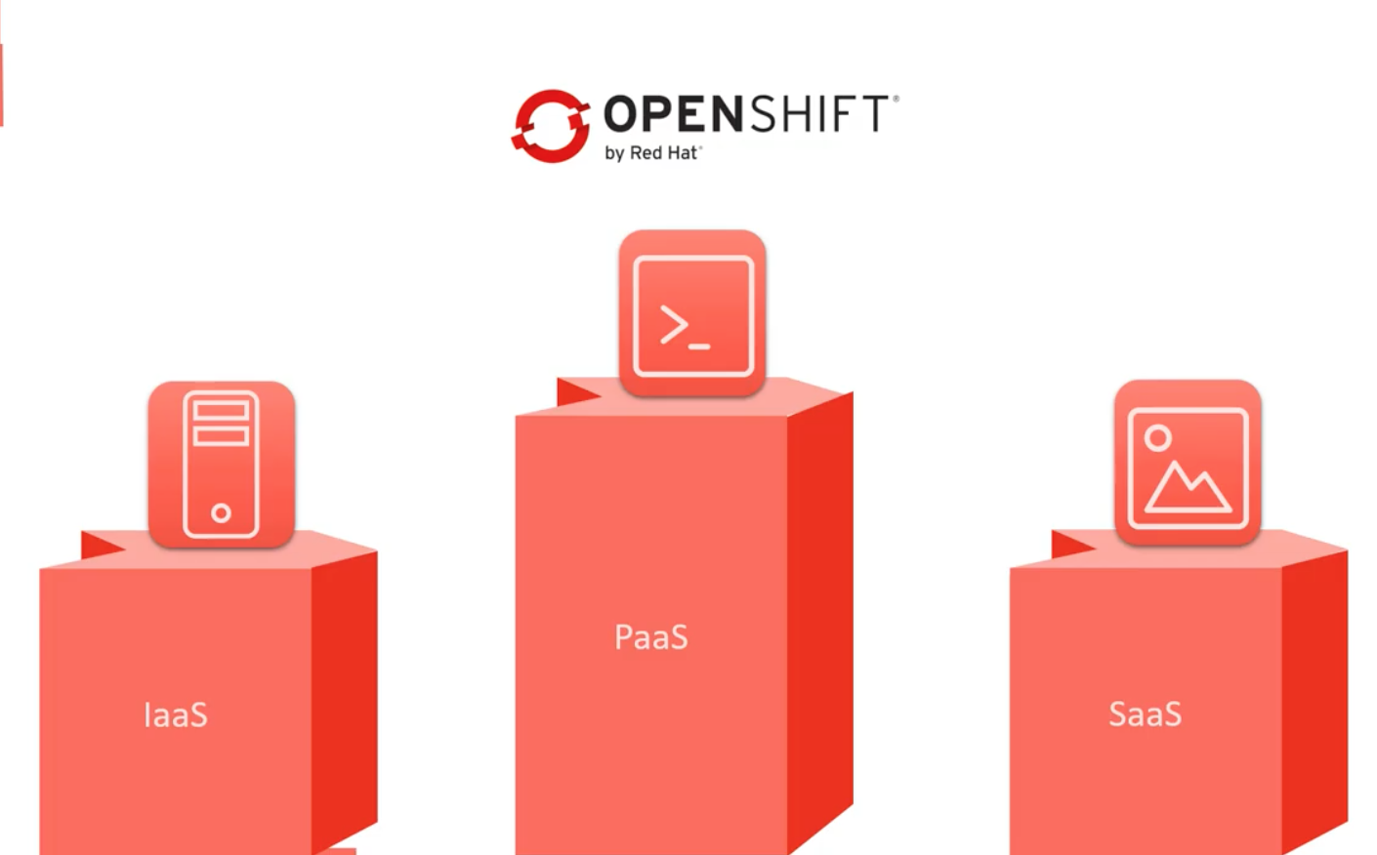

Slide 7
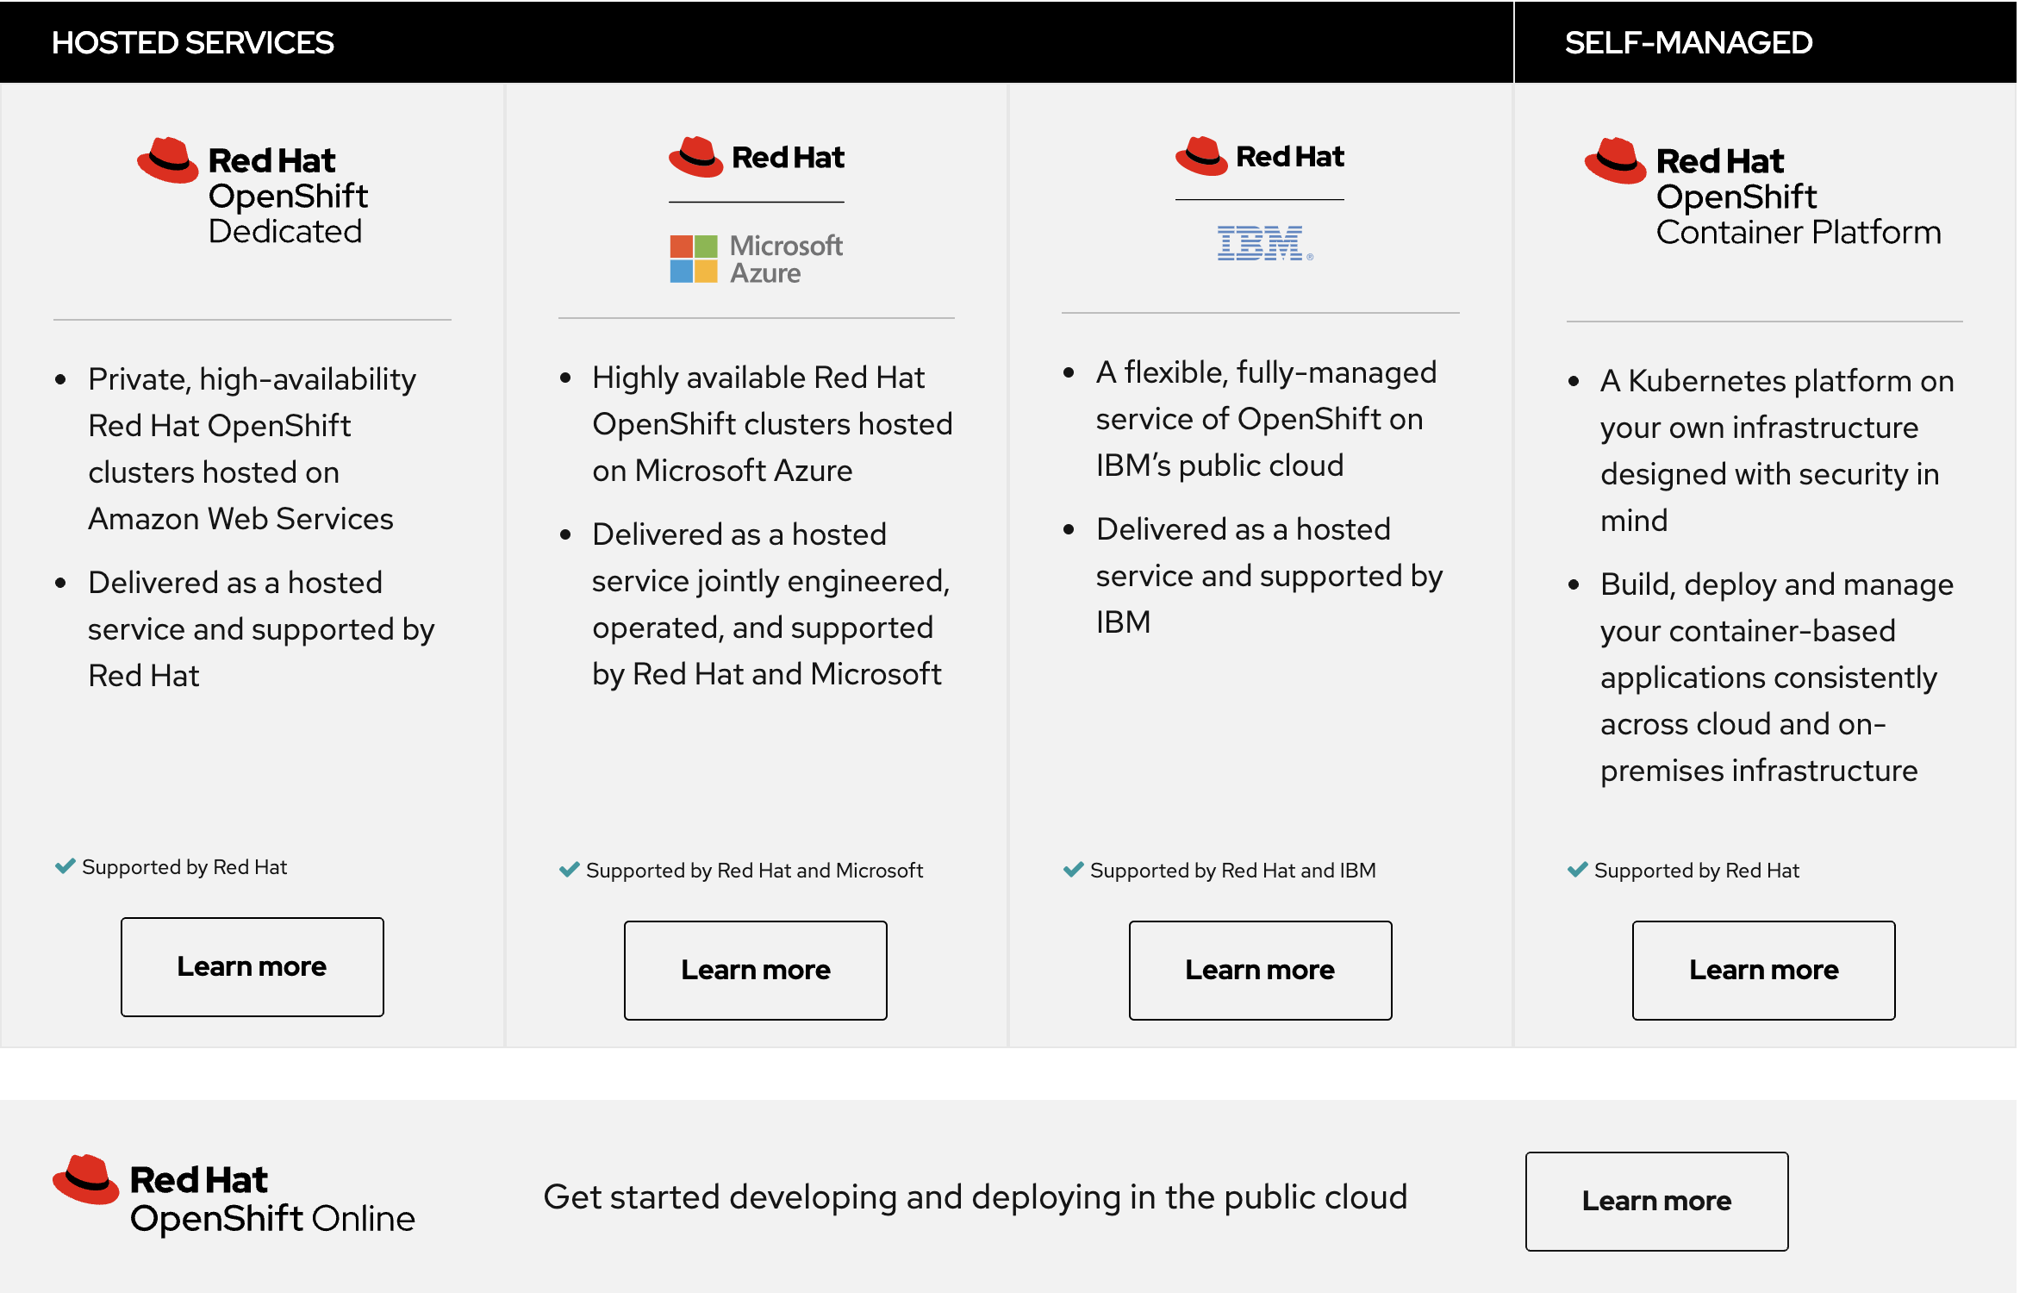
OpenShift

Slide 8
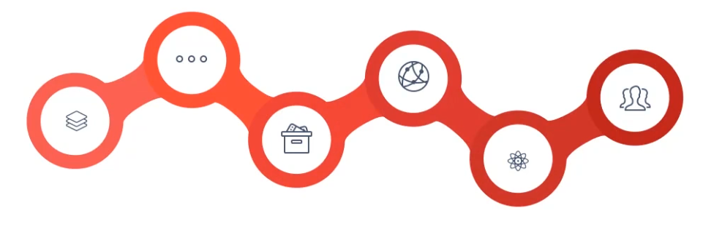
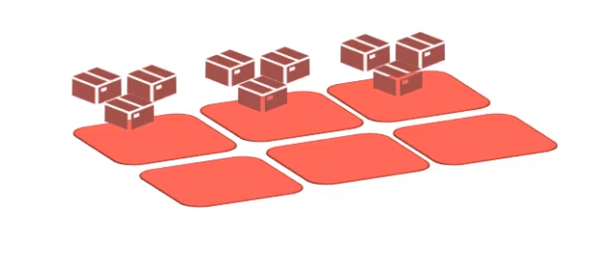

What is OpenShift?
OpenShift is based on top of CRI-O/Docker Containers and the Kubernetes Cluster Manager, with added developer and Operation Centric tools.
These tools enable rapid application Development , Deployment And Life Cycle Management.
Tools
Kubernetes
Docker

Slide 10
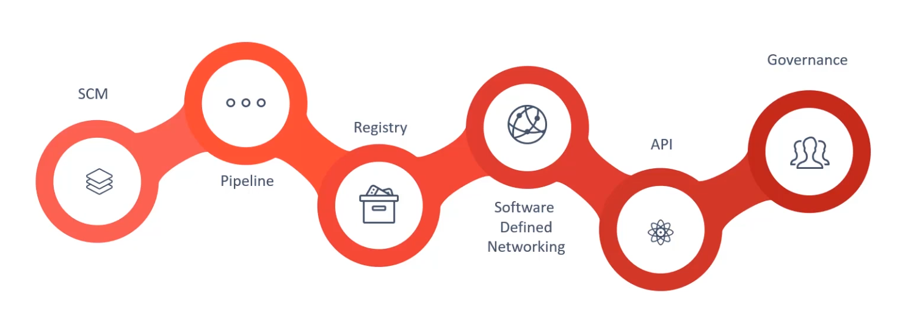
Tools
Notes:
Add support to developers tools such as source code management softwares such as GITHUB, Built in Integration with Build Pipelines – Develop, Build, Test and Deploy apps. OS manages docker images of uour apps by providing built in registry, Openshift comes with Software defined network, out of the . API centric, Rich and integrate openshift with existing infra. Out of the box support for projects teams users to organize and

Slide 11
Kubernetes / k8s : Pre-requisite
Container + Orchestration

Slide 12
Containers
Docker
Containerd
CRI-O
Other CRI runtimes: frakti
More than 5 yrs

Slide 13
Why do you need containers?
Libraries
Dependencies
OS
Hardware
Monolith env.

Slide 14
Why do you need containers?
Right – Required Hardware
Compatibility/ Dependency
Long setup time
Libraries
Dependencies
OS
Hardware

Slide 15
Why do you need containers?
Compatibility with OS
Libraries
Dependencies
OS
Hardware

Slide 16
Why do you need containers?
Compatibility to work together
Dependency on particular version supported etc
Any Upgrade/Change
Libraries
Dependencies
OS
Hardware

Slide 17
Why do you need containers?
Multiplicity
of Stacks
Disadvantages of the monolith environment:
Compatibility/ Dependency
Long setup time
Any Upgrade/Change
Different Dev/Test/Prod
Dev
Build
Ship
Libraries
Dependencies
OS
Multiplicity of hardware environments
Hardware
17

Slide 18
Add layer
Remove Compatibility/ Dependency
Without modifying underline OS
Libraries
Dependencies
????
OS
Hardware

Slide 19
Container
Remove Compatibility/ Dependency
Libraries
Dependencies
Docker/Container Runtime
OS
Hardware

Slide 20
What Container can do?
Container
Container
Container
Container
Remove Compatibility/ Dependency
Different Dev/Test/Prod
Scalability
Polygot Programming
Lib
Deps
Lib
Deps
Lib
Deps
Lib
Deps
Docker /Container Runtime
OS
Hardware

Slide 21
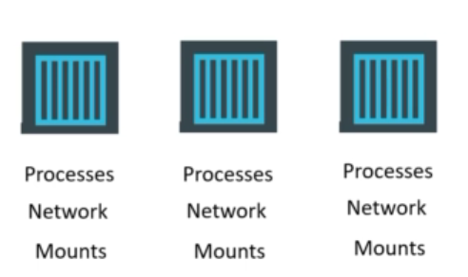
What are containers?
PID - process IDs
USER - user and group IDs
UTS - hostname and domain name
NS - mount points
NET - Network devices, stacks, ports
IPC - inter-process communications, message queues
cgroups - controls limits and monitoring of resources
OS Kernal
Docker
OS Kernal
Lxc, lxd, lxcfs

Slide 22
How Containers differ from VMs ?
Size
Bootup
Utilization
CONTAINERS
VIRTUAL MACHINES
Virtual Machine
Container
Container
Container
Container
Container
VM
Application
Application
App
App
App
App
App
App
App
App
OS Dependencies
OS dependencies
OS dependencies
OS deps
OS deps
OS deps
OS deps
Kernel
Container Host (Kernel)
Operating System
Container Host
Hypervisor
Hypervisor
Hardware
Hardware
VM Isolation
Complete OS
Static Compute
Static Memory
High Resource Usage
Container Isolation
Shared Kernel
Burstable Compute
Burstable Memory
Low Resource Usage
VM isolates the hardware
Container isolates the process
Notes:
Although possible to run every application on a single virtual machine, the operational overhead and resource cost of the multitude of extra VMs required generally invalidates the perceived benefits
Virtual machines have the advantage of providing hypervisor-level isolation for the application. However that comes at the cost of running a complete operating system for each application which consumes more memory and cpu. Furthermore, VMs compute and memory capacity is pre-defined and do not provide any elasticity or bursting more when an application requires more memory or computing power.
Containers provide isolation through taking advantage of kernel technologies like cgroups, kernel namespaces and SELinux which have been battle-tested and used for years at Google and US Department of Defense to provide application isolation
Since containers use a shared kernel and container host, they reduce the amount of resources required for the container itself and are more lightweight than virtual machines. Therefore, containers provide an unmatched agility that is not feasible with virtual machines for example it only takes a few seconds to start a new container. Furthermore, containers support a more flexible model when it comes to compute and memory resources and allow resource burst modes so that applications can consume more resources when required within the defined boundaries.

Slide 23
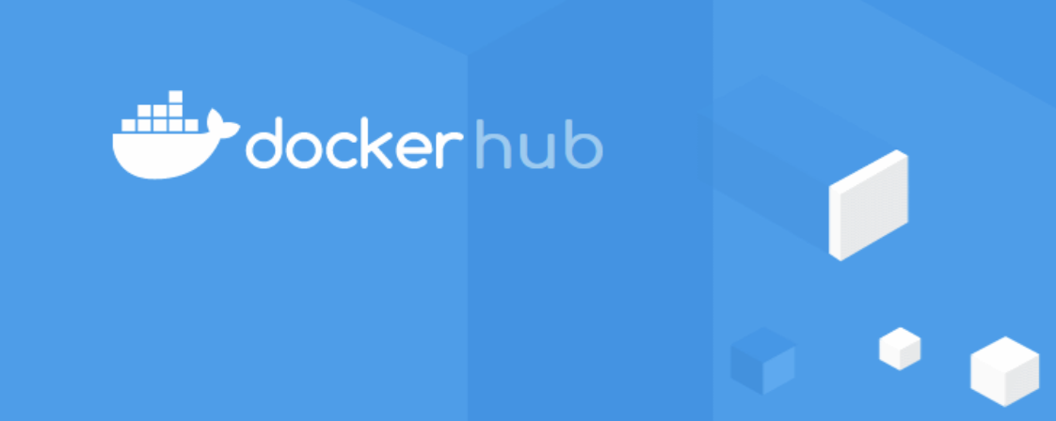
Docker
docker run ansible
docker run nodejs
docker run ansible
docker run redis
docker run nodejs
docker run nodejs

Slide 24
Docker Components
Command line Interface
Docker Engine

Slide 25
What is K8s?
Based on Google’s Borg & Omega - Open Source - Container Orchestrator
Open Governance
Cloud Native Compute Foundation
Adoption by Enterprise
RedHat, Microsoft, IBM and Amazon
Help to automate DevOps – Deployment, scaling and management of containerized apps
Helps organize container in logical units( pods, nodes)
Helps in resource monitoring and logging

Slide 26


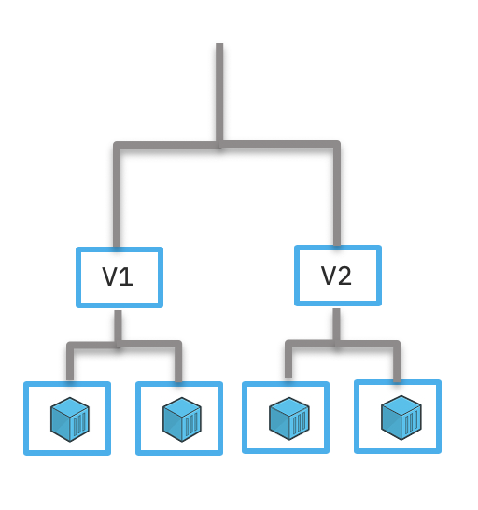





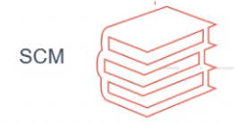
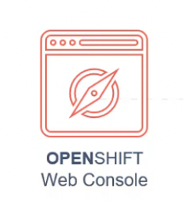



OpenShift Components
Deployment
Services
images
Containers
PODs
Kubernetes

Slide 27
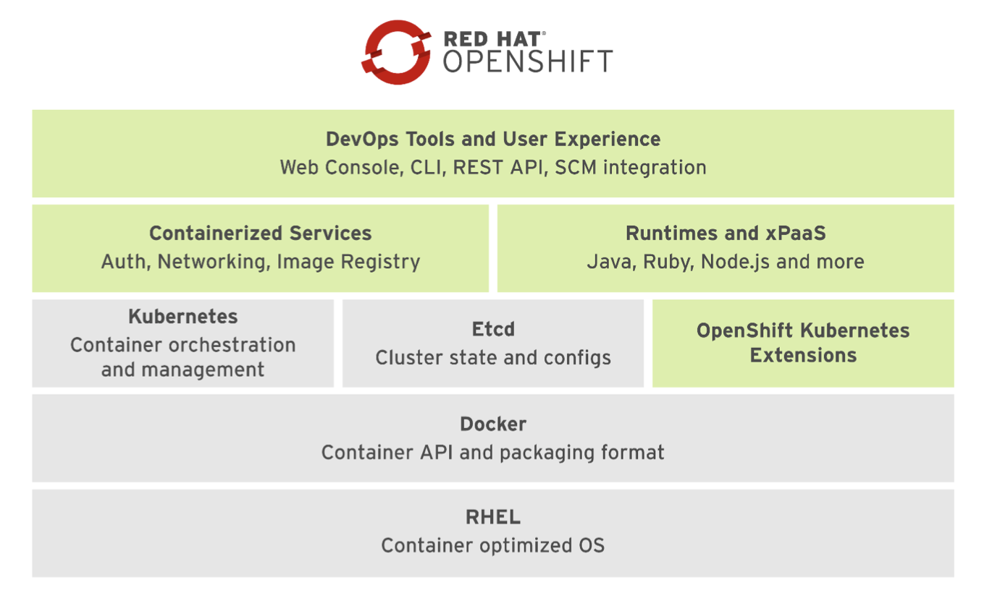

Slide 28
Kubernetes & Openshift : What’s the difference

Slide 29



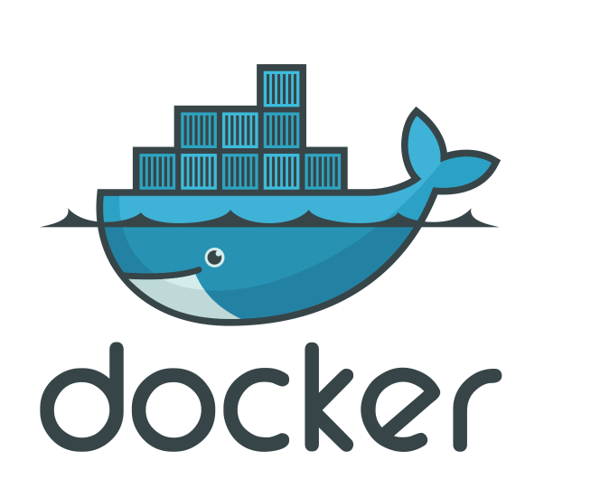

KUBERNETES / OPENSHIFT
DEPLOY
MANAGE
SECURITY
K8S
OPENSHIFT
K8S
OPENSHIFT
</>
PROJECT
RBAC
PROJECT
IAM
GRAFANA
EFK
AUTH
ISTIO …
CI/CD
OPENSHIFT
OKD K8S

Slide 30
Shared resource types:
Kubernetes and Openshift share some resource types-
Pods
Namespaces
Deployment config
Services
Persistent Volumes and Volume claims
Secrets

Slide 31
Openshift resource types:
Some resource types are unique to OpenShift
Image
Image streams
templates

Slide 32
Web Console walkthrough oc CLI walkthroguh What is a project? What is a Route? Creating a Route Scaling an app, self-healing Logging applications
OpenShift Explore

Slide 33
Web Console Walkthrough

Slide 34
CLI Walkthrough

Slide 35
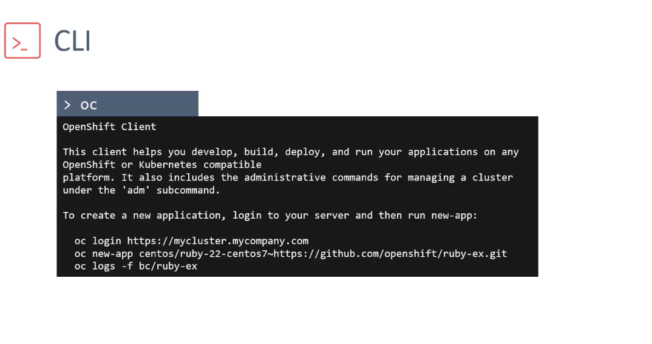
oc CLI can be downloaded from the OpenShift website. However it comes pre-packaged with Minishift utility.
Login using a username and password. For this use oc login command . Or

Slide 36
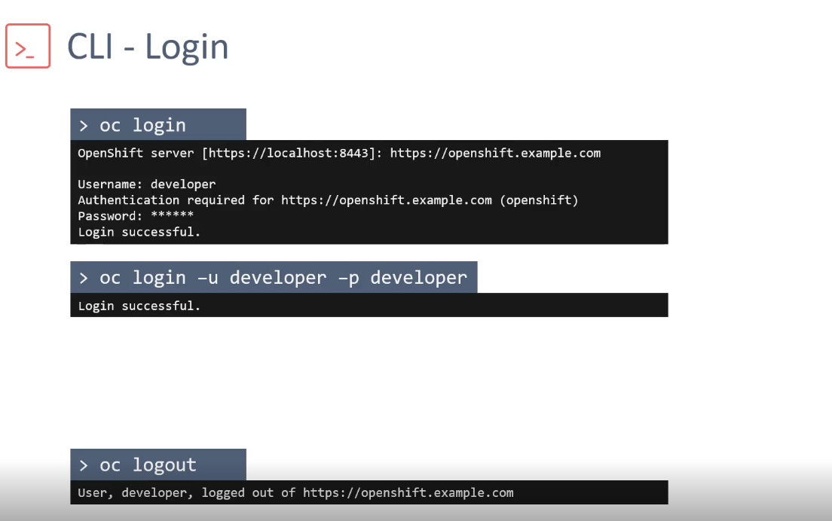
Login & Logout commands :

Slide 37
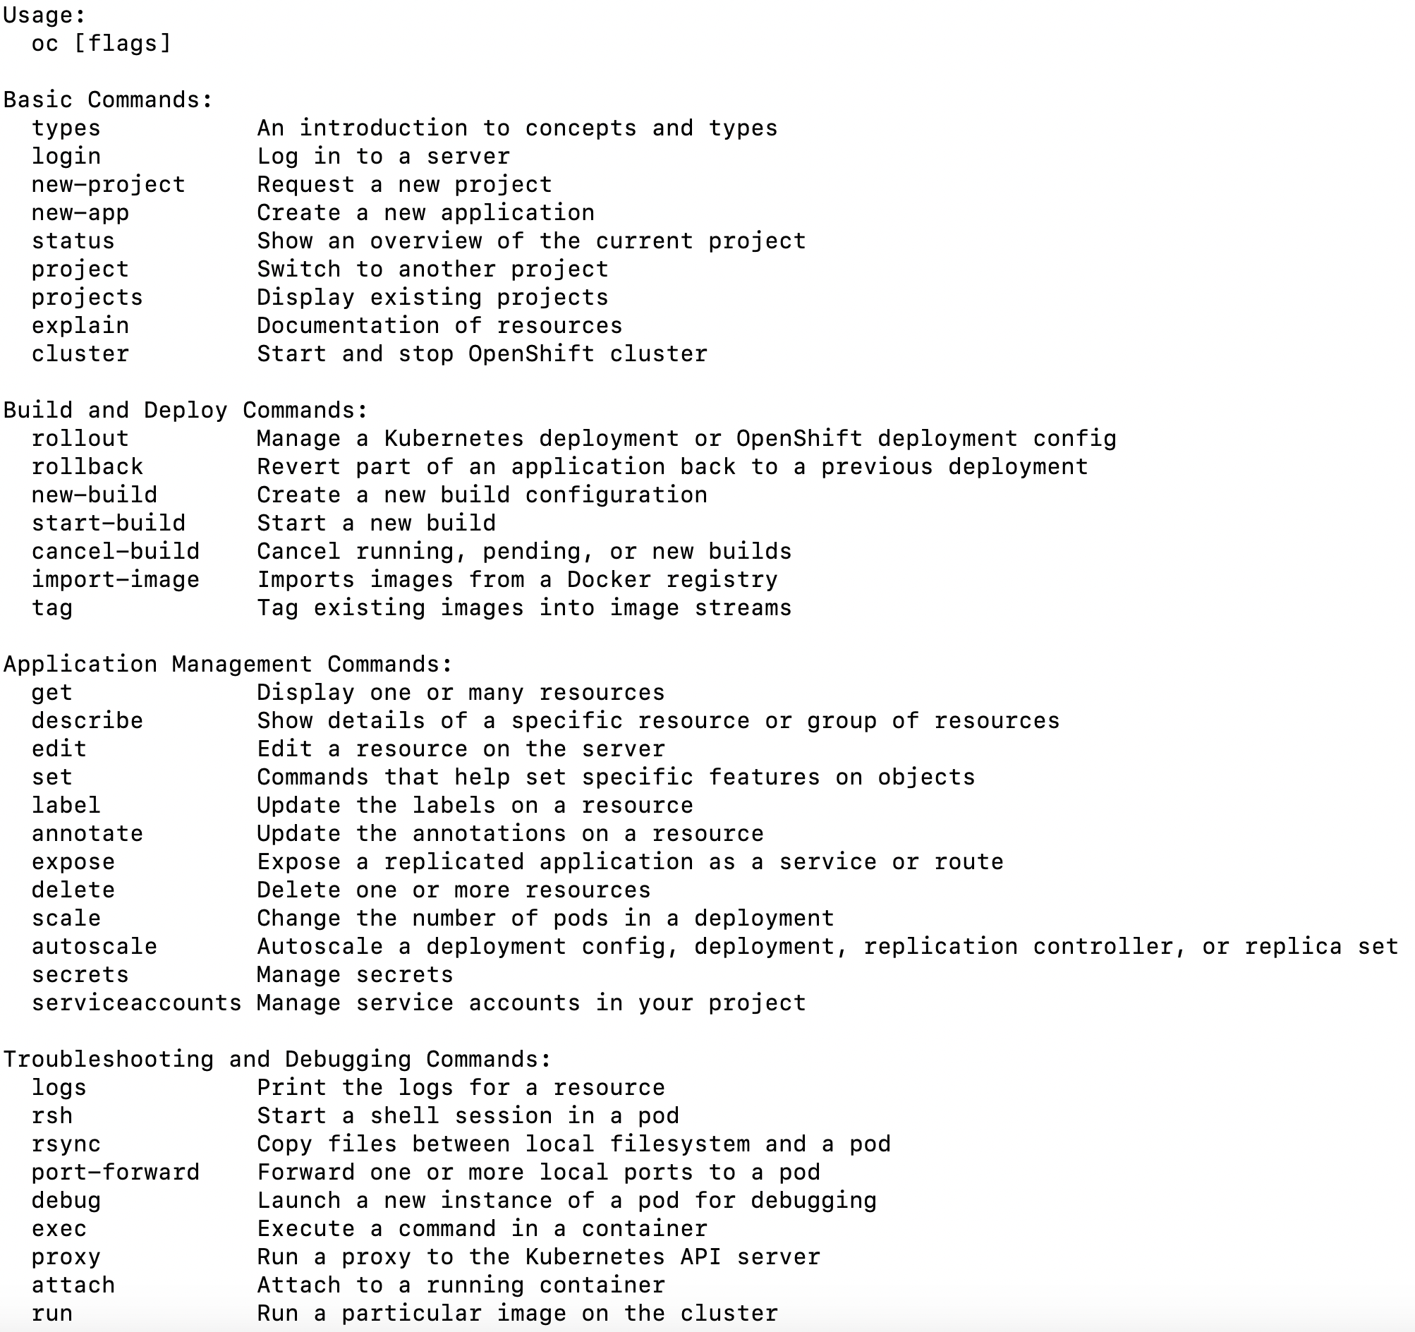
More Details

Slide 38
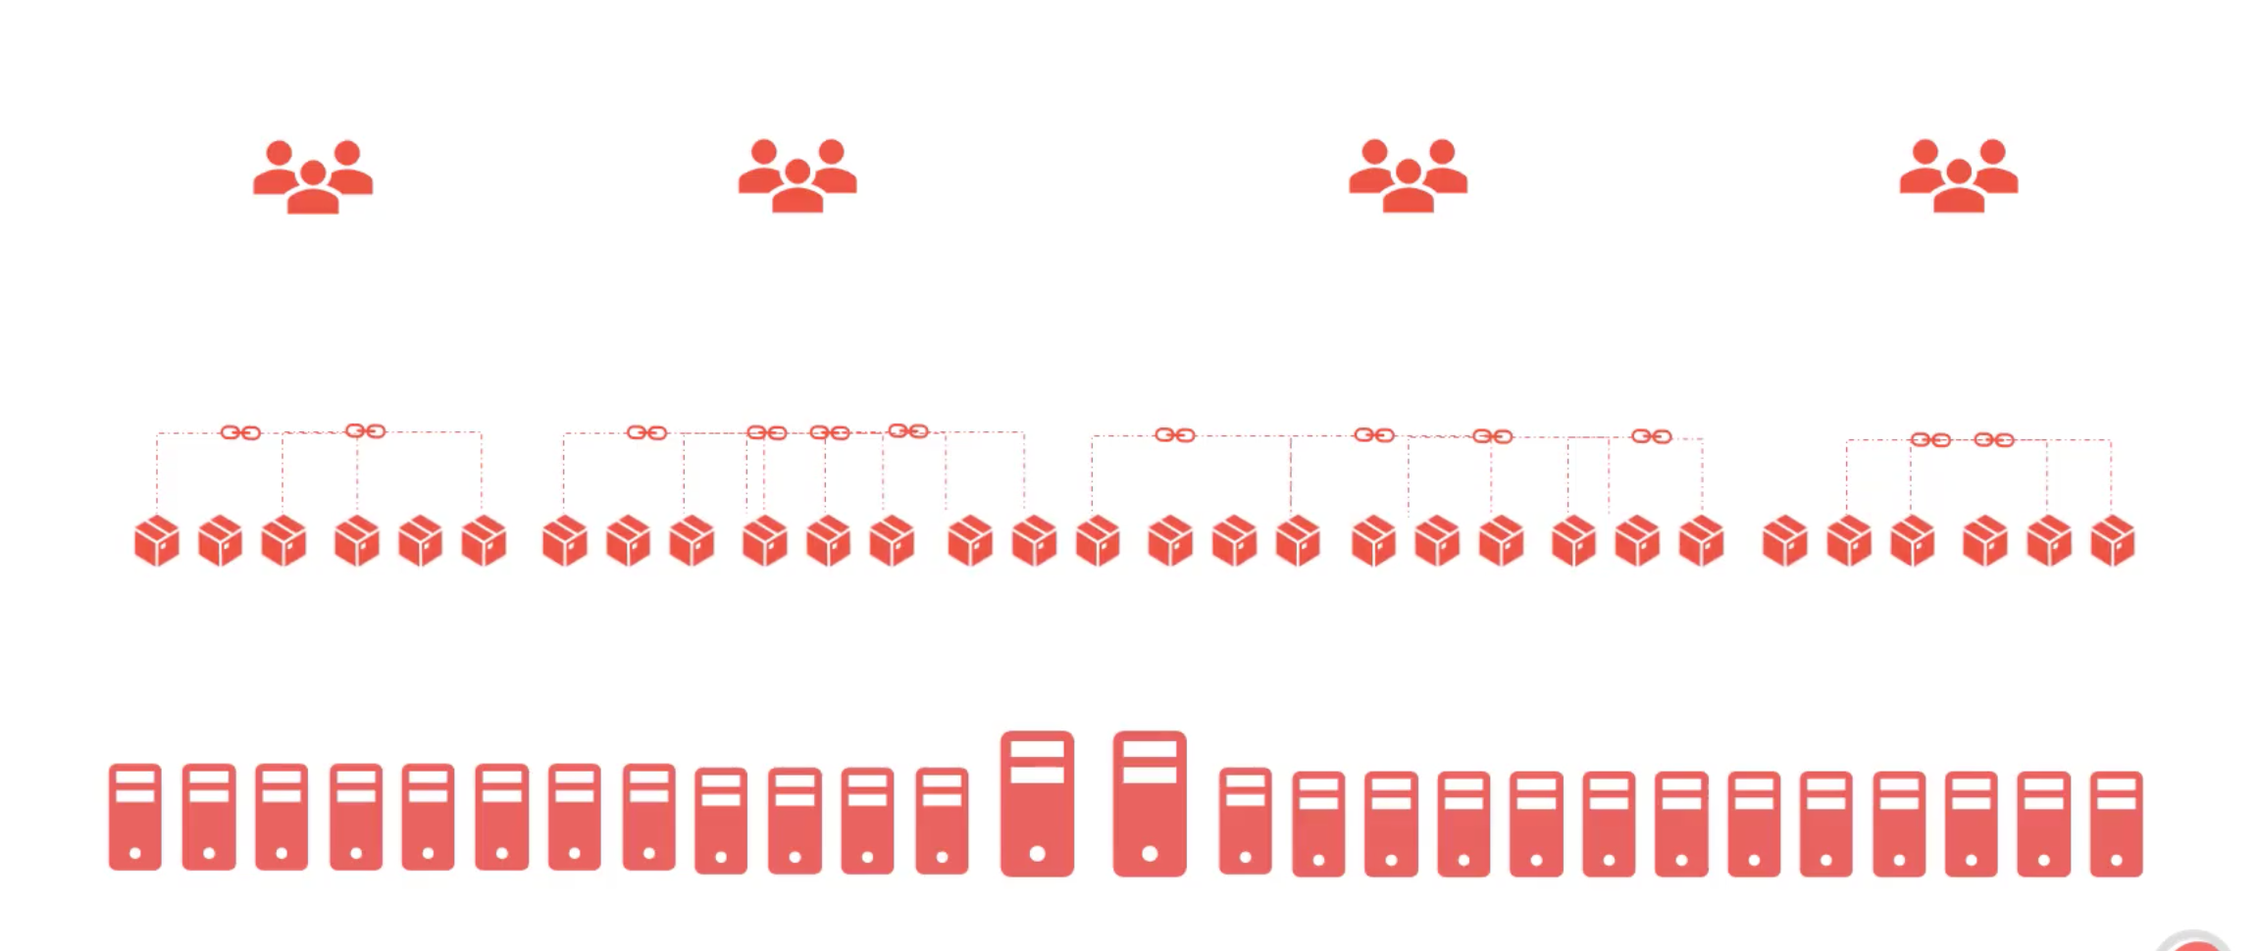
Projects
Projects

Slide 39
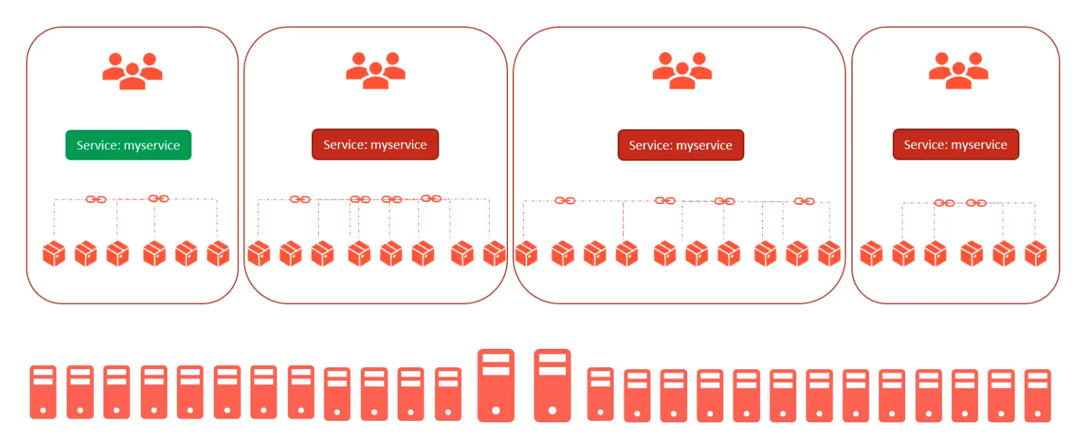
Projects

Slide 40
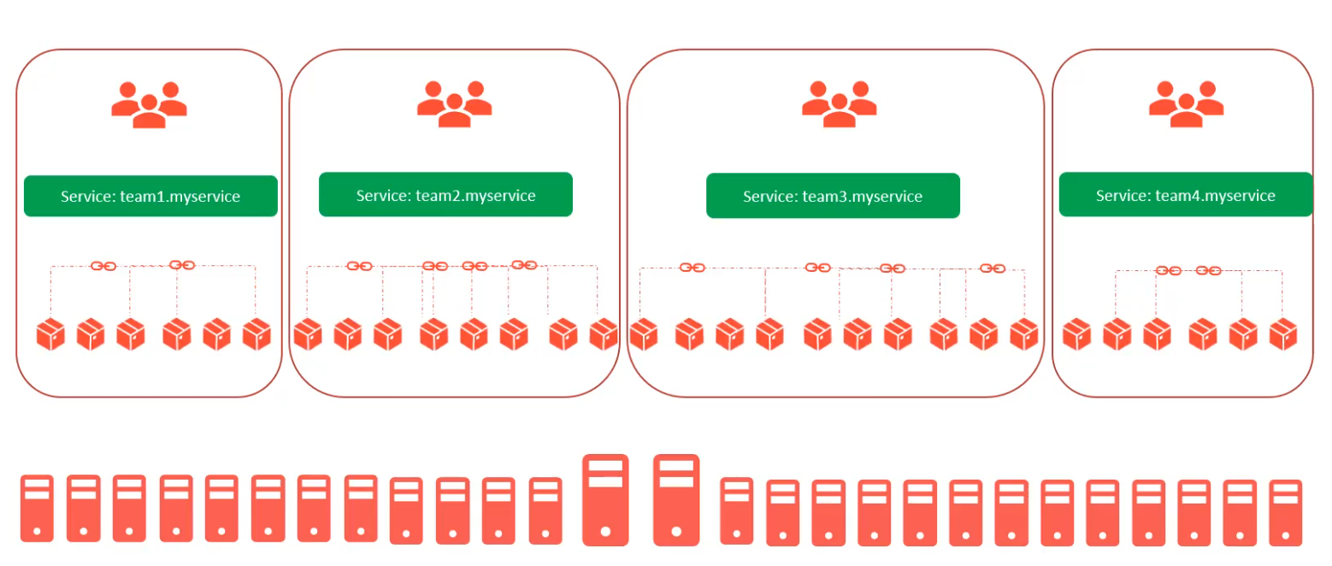
Isolation with Projects
Projects

Slide 41
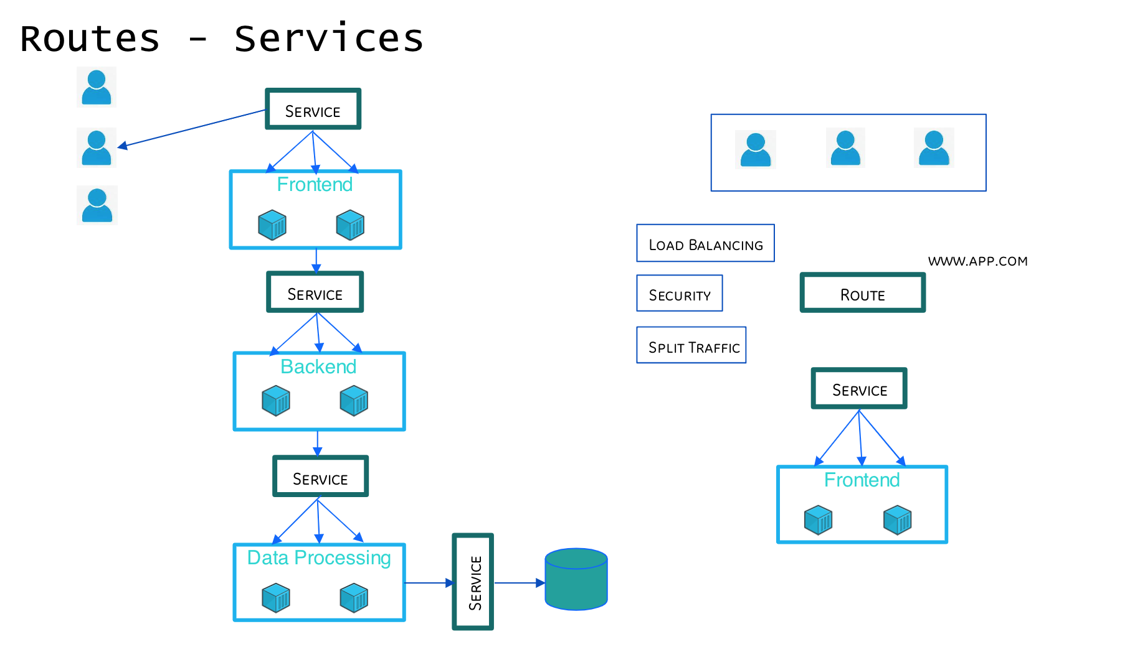




Slide 42
Understanding Routes
OpenShift routes allow network access to pods from outside the Openshift environment.
A dedicated router pod is used to load-balance traffic between the target pods.
The router pods uses HAProxy and can be scaled itself.
The router exposes a public facing IP address and DNS hostname to the internal pod networking.
Routers connect directly to the pods, the service is used for pod lookup only, but not involved in the actual traffic.

Slide 43
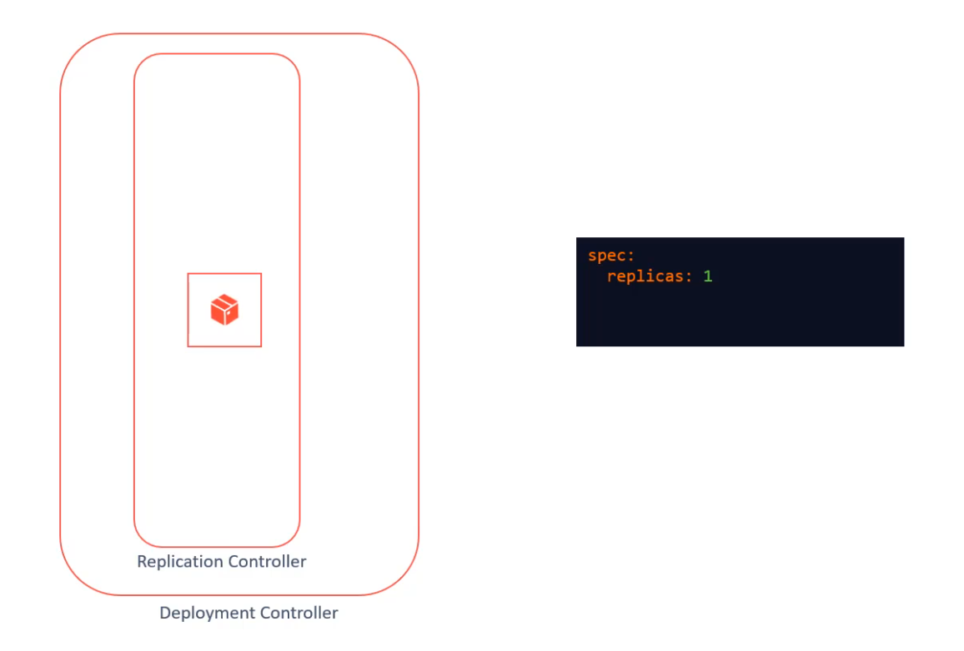
Scale

Slide 44
Scale ( Contd..)

Slide 45
Agenda:
Cloud Pak
Types of Cloud Paks
Cloud Pak For Applications
Cloud Foundry Lab deployment

Slide 46
IBM Containerized Software's on OpenShift Container Platform

Slide 47
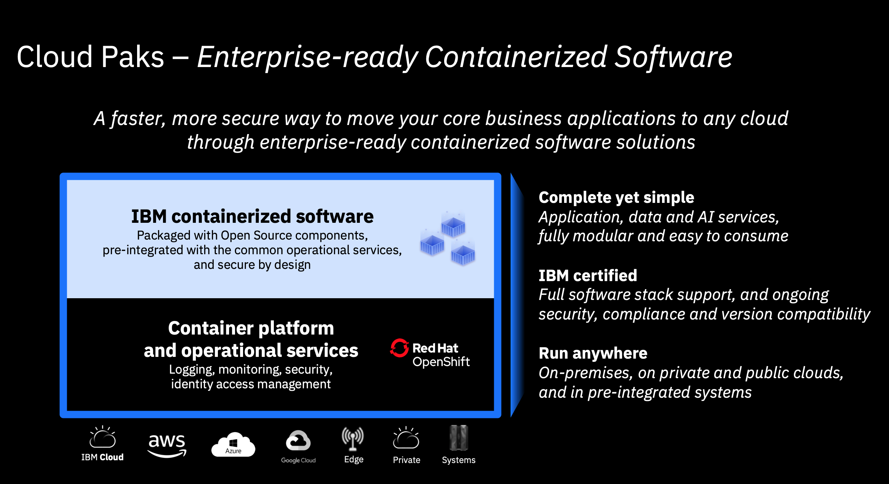

Slide 49
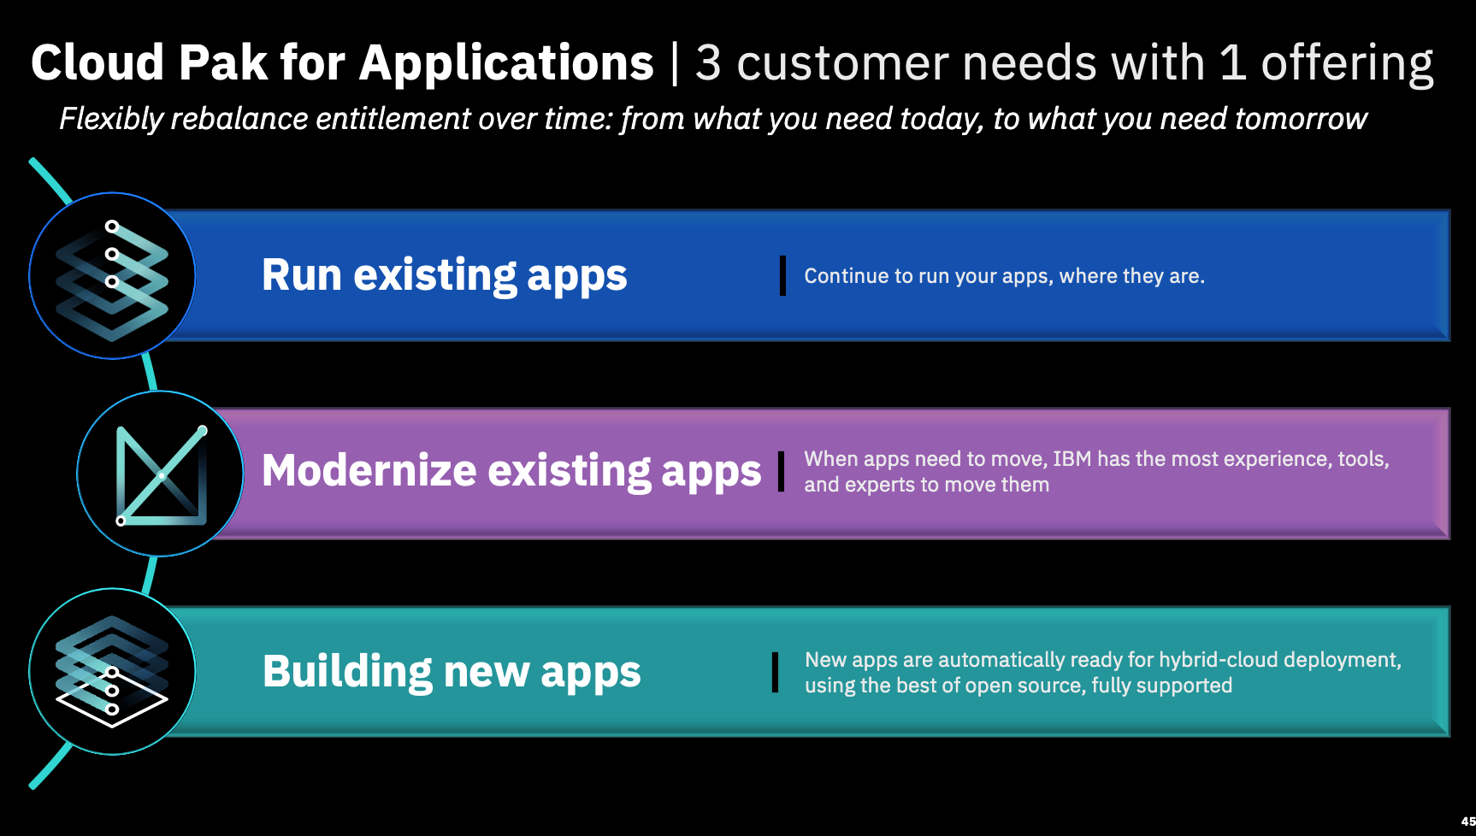

Slide 50
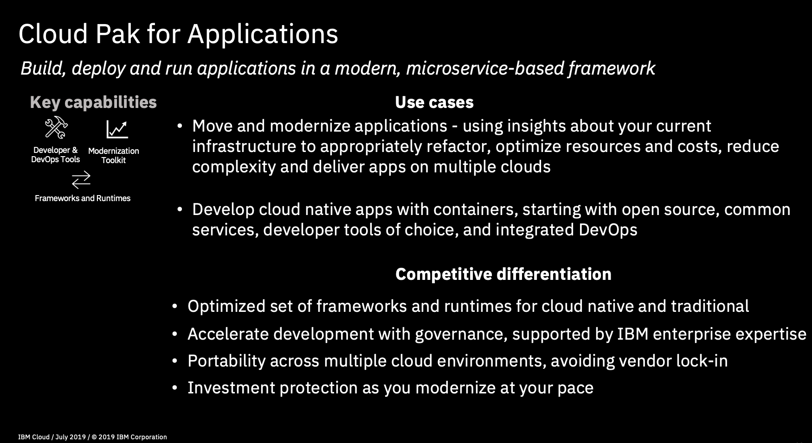

Slide 51
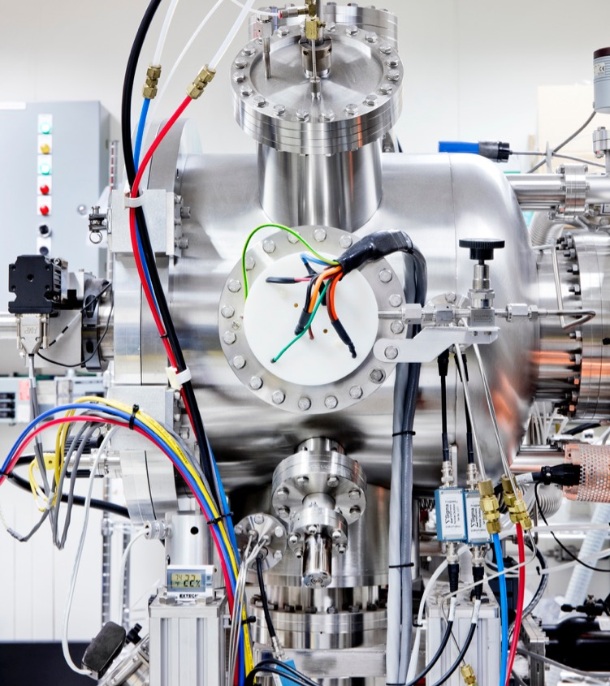
Lab1 Time!

Slide 52
